Slide 1
A Hand Gesture Recognition System
Based on Local Linear Embedding
Presented by Chang Liu
2006. 3

Slide 2
Outline
Introduction
CSL and Pre-processing
Locally Linear Embedding
Experiments
Conclusion

Slide 3
Introduction
Interaction with computers are not comfortable experience
Computers should communicate with people with body language.
Hand gesture recognition becomes important
  Interactive human-machine interface and virtual environment

Slide 4
Introduction
Two common technologies for hand gesture recognition
  glove-based method
    Using special glove-based device to extract hand posture
    Annoying
  vision-based method
    3D hand/arm modeling
    Appearance modeling

Slide 5
Introduction
3D hand/arm modeling
  Highly computational complexity
  Using many approximation process
Appearance modeling
  Low computational complexity
  Real-time processing

Slide 6
Introduction
Overview of algorithm proposed in the paper
  Vision-based method to be used for the problem of CSL real-time recognition
  Input: 2D video sequences
  two major steps
    Hand gesture region detection
    Hand gesture recognition

Slide 7
CSL and Pre-processing
Sign Language
  Rely on the hearing society
  Two main elements:
    Low and simple level signed alphabet, mimics the letters of the native spoken language
    Higher level signed language, using actions to mimic the meaning or description of the sign

Slide 8
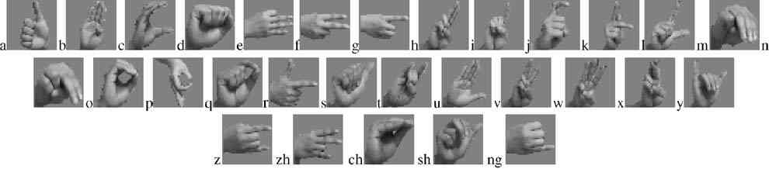
CSL and Pre-processing
CSL is the abbreviation for Chinese Sign Language
30 letters in CSL alphabet ←→ Objects in recognition

Slide 9
Pre-processing of
Hand Gesture Recognition
Detection of Hand Gesture Regions
Aim to fix on the valid frames and locate the hand region from the rest of the image.
Low time consuming → fast processing rate → real time speed

Slide 10
Pre-processing of
Hand Gesture Recognition
Detect skin region from the rest of the image by using color.
Each color has three components
  hue, saturation, and value
  chroma consists of hue and saturation is separated from value
  Under different condition, chroma is invariant.

Slide 11
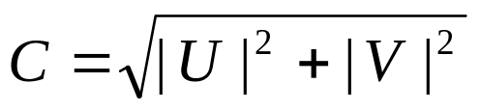

Pre-processing of
Hand Gesture Recognition
Color is represented in RGB space, also in YUV and YIQ space.
In YUV space
  saturation → displacement
  hue -> amplitude
In YIQ space
  The color saturation cue I is combined with Θto reinforce the segmentation effect

Slide 12
Pre-processing of
Hand Gesture Recognition
Skins are between red and yellow
Transform color pixel point P from RGB to YUV and YIQ space
Skin region is:
  105 º <= Θ<= 150 º
  30 <= I <= 100
  Hands and faces

Slide 13
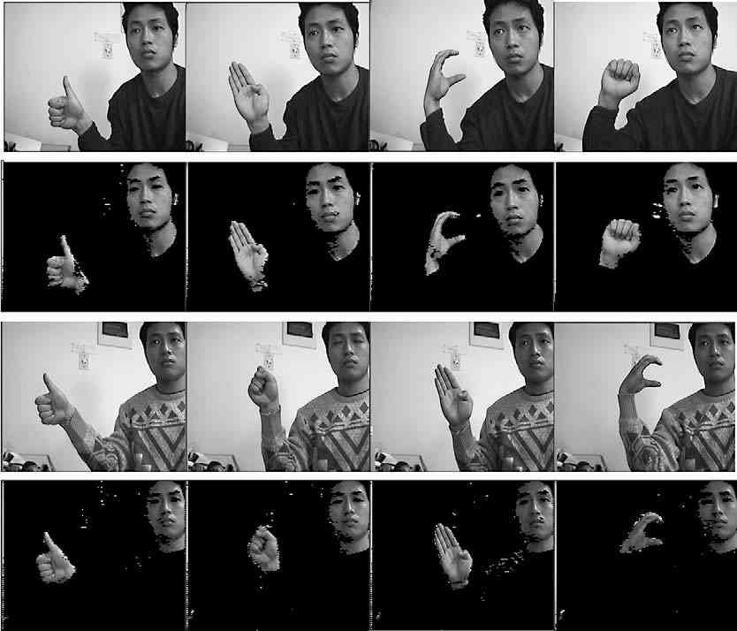
Pre-processing of
Hand Gesture Recognition

Slide 14
Pre-processing of
Hand Gesture Recognition
On-line video stream containing hand gestures can be considered as a signal S(x, y, t)
  (x,y) denotes the image coordinate
  t denotes time
Convert image from RGB to HIS to extract intensity signal I(x,y,t)

Slide 15
Pre-processing of
Hand Gesture Recognition
Based on the representation by YUV and YIQ, skin pixels can be detected and form a binary image sequence M’(x,y,t) – region mask
Another binary image sequence M’’(x,y,t) which reflects the motion information is produced between every consecutive pair of intensity images – motion mask

Slide 16
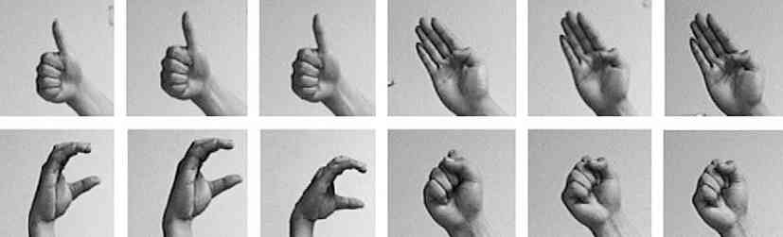
Pre-processing of
Hand Gesture Recognition
M(x,y,t) delineating the moving skin region by using logical AND between the corresponding region mask and motion mask sequence

Slide 17
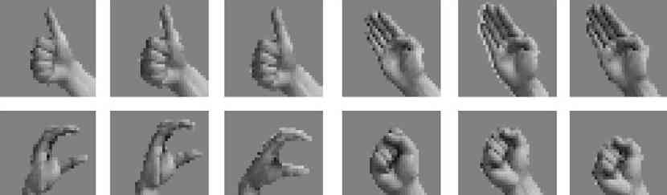
Pre-processing of
Hand Gesture Recognition
Normalization
  Transformed the detection results into gray-scale images with 36*36 pixels.

Slide 18
Locally Linear Embedding
Sparse data vs. High dimensional space
  30 different gestures, 120 samples/gesture
  36*36 pixels
  3600 training samples vs. d = 1296
  Difficult to describe the data distribution
  Reduce the dimensionality of hand gesture images

Slide 19


Locally Linear Embedding
Locally Linear Embedding maps the high-dimensional data to a single global coordinate system to preserve the neighbouring relations.
Given n input vectors {x1, x2, …, xn},
➔ LLE algorithm
➔ {y1, y2, …, yn} (m<<d)

Slide 20
Locally Linear Embedding
Find the k nearest neighbours of each point xi
Measure reconstruction error from the approximation of each point by the neighbour points and compute the reconstruction weights which minimize the error
Compute the low-embedding by minimizing an embedding cost function with the reconstruction weights

Slide 21
Experiments
4125 images including all 30 hand gestures
60% for training , 40% for testing
For each image:
  320*240 image, 24b color depth
  Taken from camera with different distance and orientation
  Sampled at 25 frames/s

Slide 22
Experiment Results
Data | # of Samples | Recognized Samples | Recognition Rate (%)
Training | 2475 | 2309 | 93.3
Testing | 1650 | 1495 | 90.6
Total | 4125 | 3804 | 92.2

Slide 23
Conclusion
Robust against similar postures in different light conditions and backgrounds
Fast detection process, allows the real time video application with low cost sensors, such as PC and USB camera

Slide 24
Thank You!
Questions?

